Slide 1
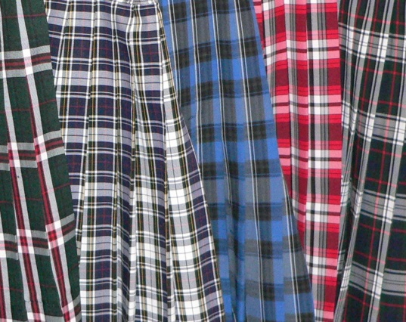
Highland Games

Slide 2
Bagpipers

Slide 3
Bagpipers

Slide 4
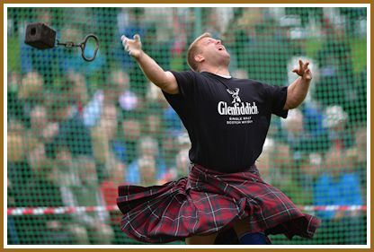
Competitions
Hammer Throw
Shot Put

Slide 5
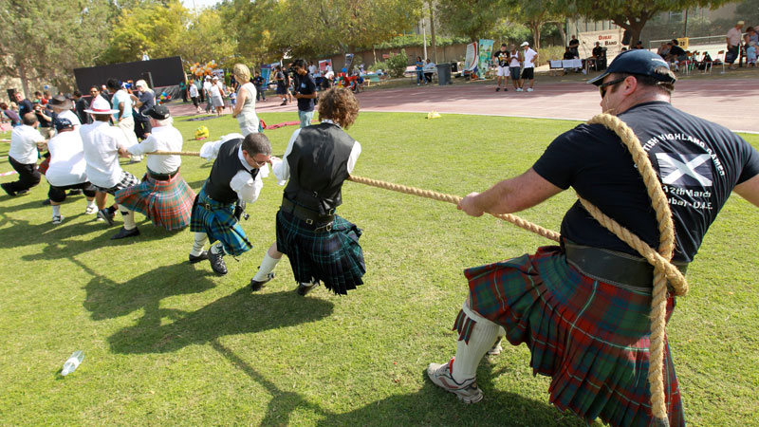
“Tug of War”

Slide 6
Tossing the caber

Slide 7
Dancing competitions

Slide 8
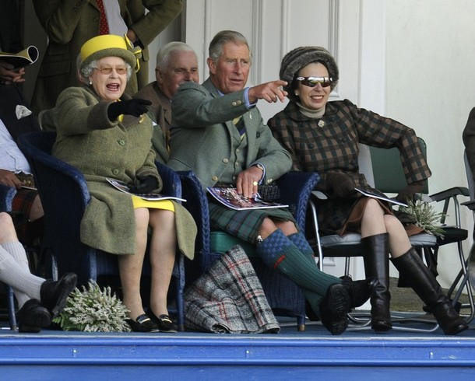
The Queen’s Family

